Slide 1

207: Developing Family Leadership:
Using Data to Help Develop Practice
March 14, 2012

Slide 2
WebEx Instructions:
All participants will be muted except during question and answer slides
Use raise hand or chat feature to share ideas and questions with the presenters
Contact 717-795-9048 for technical difficulties
Complete evaluation

Slide 3
PRESENTERS:
Guest Presenter:
William Browning, Lackawanna County Children and Youth Services Administrator
Child Welfare Training Program staff:
Andrea Richardson, Practice Improvement Specialist
Mary E. Rauktis Ph.D., Research Assistant Professor
Shauna Reinhart, Program Development Specialist
Christopher Nobles, Youth Ambassador

Slide 4
PURPOSE
In this webinar, participants will learn about defining family leadership in their agency, how to use the county and state fidelity data to measure their practice, and techniques and available tools that can be used to grow practice in the community.

Slide 5
LEARNING OBJECTIVES:
Participants will be able to:
Define Family Leadership in the context of case planning and organizational development;
Examine how current data resources can be used to help measure an individual county’s progress and develop future plans; and
Identify key techniques and tools that can be replicated in their community.

Slide 6
AGENDA:
Welcome and Introductions
Defining Family Leadership and Exploring the Data
One Agency’s Efforts to Establish Family Leadership
The Roadmap to Youth and Family Engagement
Closing

Slide 7
Family Leadership
Empowerment of the family to make a plan.
Relationship of the facilitator to the family.
Relationship among family group members.
Support of family as competent decision makers.
Balance of power between providers and family.
Positioning of the family at the center of the search for solutions.
(Pennell & Anderson, 2005).

Slide 8
Family Leadership is the key!!
Family center of the solution finding process.
State’s support of family engagement as a strategy for improving outcomes.
If we are not true to the model; what are we really doing?
If we are not realizing anticipated outcomes, why?

Slide 9
Measuring Family Leadership
2. The FGDM facilitator was respectful of the family group.
3. The FGDM facilitator/coordinator did not have other jobs to do with the family beside organizing and/or facilitating the group.
7. More family group than paid professionals participated in the conference.

Slide 10
Measuring Family Leadership, cont’d
8. Different sides of the family participated in the conference.
13. Paid Professionals shared their knowledge but they did not tell the family group how to solve the concerns.
14. The family group had private time to make their plan.
15. The family plan included ways that the family group will help out.

Slide 11
Family Leadership Data
Statewide
Lackawanna County
7-12/2010:
Mean- 3.33
Median- 3.28
Mode- 3.00
1-6/2011:
Mean- 3.53
Median- 3.57
Mode- 4.00
7-12/2010:
Mean- 3.51
Median- 3.57
Mode- 4.00
1-6/2011
Mean- 3.61
Median- 3.57
Mode- 4.00

Slide 12
What does it mean?
Significance of the data
Family leadership is an area for growth in PA’s FGDM practice
Implications for practice

Slide 13
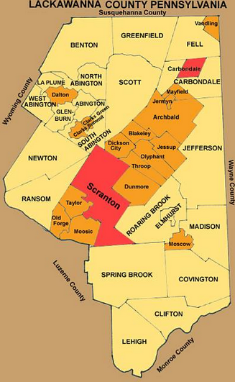
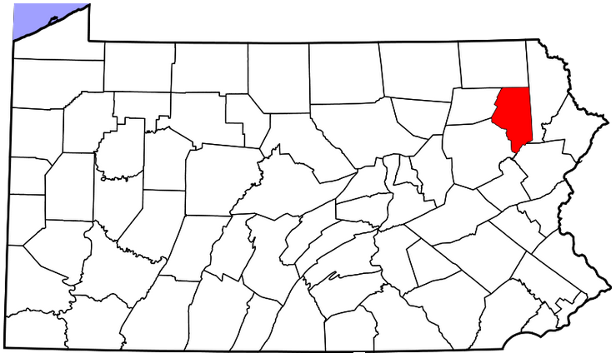
Lackawanna County’s
Approach to Family
Engagement

Slide 14

QUESTIONS:

Slide 15
The Roadmap to Youth and Family Engagement
Purpose
The Roadmap is a quick and easy tool to help support and sustain parent and youth engagement and to build highly functioning boards. It provides information and resources to drive collaboration between youth, young adults, family members, state officials, child welfare professionals, cross system partners, and communities.

Slide 16
The Roadmap to Youth and Family Engagement, cont’d
How to Use
The Roadmap presents a framework for youth and family engagement on advisory boards; users can access any part of the guide through the table of contents for useful information and concrete tools and resources. References and web links are located throughout and can be accessed directly from the document.

Slide 17
The Roadmap to Youth and Family Engagement, cont’d
Readiness
Assessment
Recruitment
Selection
Orientation
Support &
Mentoring
Monitoring
and
Continuous
Quality
Improvement

Slide 18
QUESTIONS:

Slide 19

For additional information or
resources, please contact
Pennsylvania
Child Welfare Training Program
www.pacwcbt.pitt.edu
717-795-9048
www.independentlivingpa.org Families and Communities United
www.fcu.pitt.edu

